Slide 1
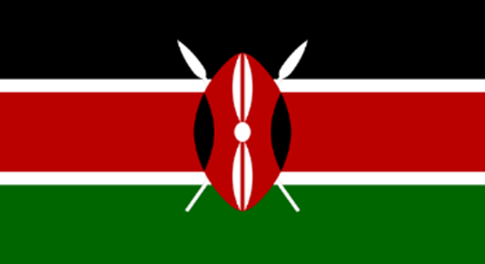
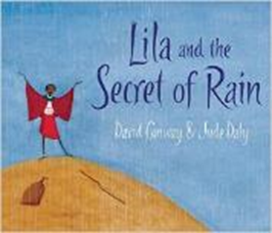
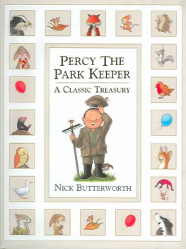
Scented Garden KS1 Knowledge Mat
Subject Specific Vocabulary |  |  | Exciting Books
North Pole | The North Pole is the northernmost place on Earth. When at the North Pole all directions point south.
South Pole | The South Pole is the southernmost place on Earth. When at the South Pole all directions point north.
Equator | An imaginary line around the centre of the Earth. It is very hot at the Equator. It divides the Earth into the north and south hemispheres.
European | To be European is to belong to a group of countries in a continent called Europe. | Sticky Knowledge
African | To be African is to belong to a group of countries in a continent called Africa. | Not all deserts are covered by sand. Only 20% of all deserts are covered with sand.
 |  |  | Kenyan animals
Kenya | Is a large country situated in East Africa. It is officially known as the Republic of Kenya. | During the South Pole winter it is dark all the time. During the summer it is light all the time.
 |  |  | African elephant Rhinoceros Hippopotamus Giraffe Zebra
 |  | Not all deserts are hot. Two of the world’s biggest deserts are in the North and South Poles.
desert | A desert is a very dry place that experiences little rain and therefore plants don’t grow there. It is difficult to find water in a desert.
tropical | Places that are near to the equator. The weather is hot and dry. | Kenya is situated in Eastern Africa and the capital of Kenya is Nairobi. | Kenyan fruit
climate | Climate refers to aspects of weather over a long time. In hot countries the climate is normally warm. | Many bird species migrate to either warmer or cooler climates. | Banana Orange Pear Passion fruit Pineapple
migration | The movement of people and animals from one place to another. | Unfortunately, Kenya is still a developing country and more than half the population live in poverty.

Slide 2
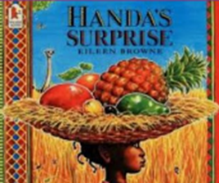
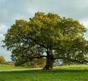
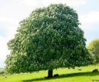
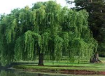
Year 2: Plants and Trees Knowledge Mat
Subject Specific Vocabulary |  | Interesting Books | Sticky Knowledge
roots | It is the part of a plant that is usually hidden under the ground. They make the plant stable and give it nutrients.
 |  |  | Trees and shrubs take in water and carbon dioxide and give out oxygen.
seed | A small grain produced by a plant that once plant can produce a plant.
identify | To recognise or pick out certain items.
 |  |  | Trees can live for a very long time. The oldest known tree is over 5000 years old.
classify | To group and arrange items into categories.
 |  | Common trees found in the UK | The roots of a plant carry food and water from the ground to the leaves .
stamen | The part of a flower that produces pollen.
bulb | Bulbs are underground masses of food storage from which plants grow.
 |  |  | The trunk is the main body of the tree. The trunk is covered with bark which protects it from damage.
trunk | A tree's trunk holds up its crown, protects its inner parts and works like a pipeline, transporting essential materials to the different parts of the tree.
stem | The stem is the main part of the plant. It supports the weight of the leaves, as well as the flowers or fruit.
 |  |  | The leaves can be of many different shapes. They can be used to identify different varieties of trees.
habitat | The place where a plant or animal (mostly) lives. There are different kinds of habitats, such as grassland, forest, river, sea and desert.
 |  |  | Seeds germinate and grow into plants.
germinate | To begin to grow and put out shoots.
oak
Horse chestnut
conifer
willow

